Slide 1
(Dynamic) Memory in C / C++

Slide 2
Introduction
You are probably familiar with a line of code like this in Java.
ArrayList<Integer> scores = new ArrayList<Integer>();
This line of code allocates memory necessary to represent an ArrayList object (an array of a default length).
Consider the allocation within the context of a method.
public void function()
{
ArrayList<Integer> scores = new ArrayList<Integer>();
// ...
}
What happens to memory when we leave the method? We must be able to reclaim that memory.
Java identifies and frees objects using a process called garbage collection.

Slide 3
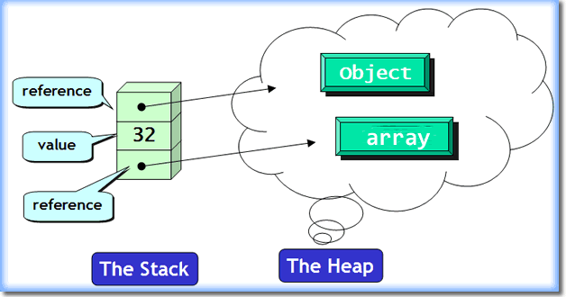
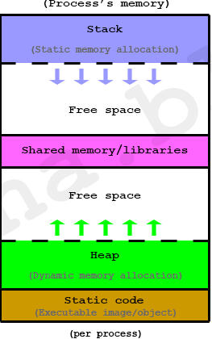
Major Areas of Memory
Static Area
Fixed size, fixed content, allocated at compile time
Run-time stack
Variable size, variable content (activation records)
Used for managing function calls and returns
Heap
Fixed size, variable content
Dynamically allocated objects and data structures
Examples: ML reference cells, malloc in C, new in C++/Java/C#

Slide 4
Why Garbage Collection?
Programs today consume storage freely
16GB laptops, 256GB desktops, 512+GB servers
64-bit address spaces (SPARC, Itanium, Opteron)
… and mismanage it
Memory leaks,
Dangling references,
Double free,
Misaligned addresses,
Null pointer dereference,
Heap fragmentation
Poor use of reference locality, resulting in high cache miss rates and/or excessive demand paging
Explicit memory management breaks high-level programming abstraction.
Explicit memory management is a pain…but we are going to look at it.

Slide 5

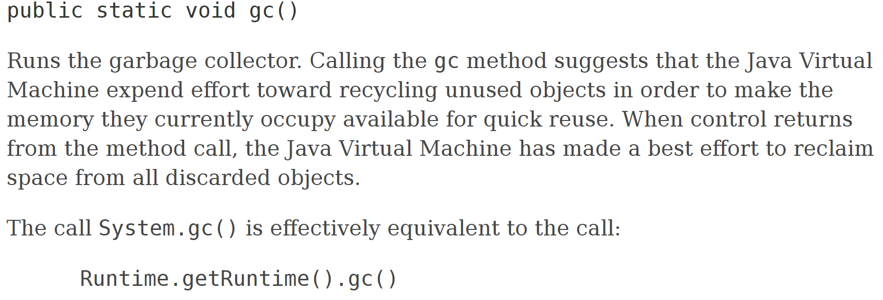
Garbage Collection in Java
Purpose
Find and delete unreachable objects.
Free space as much as possible.
When?
Garbage Collection (GC) is under control of the Java Virtual Machine (JVM)
You can request collection, but there are no guarantees.
How?
Discovers unreachable objects.
Reference counting is one technique

Slide 6
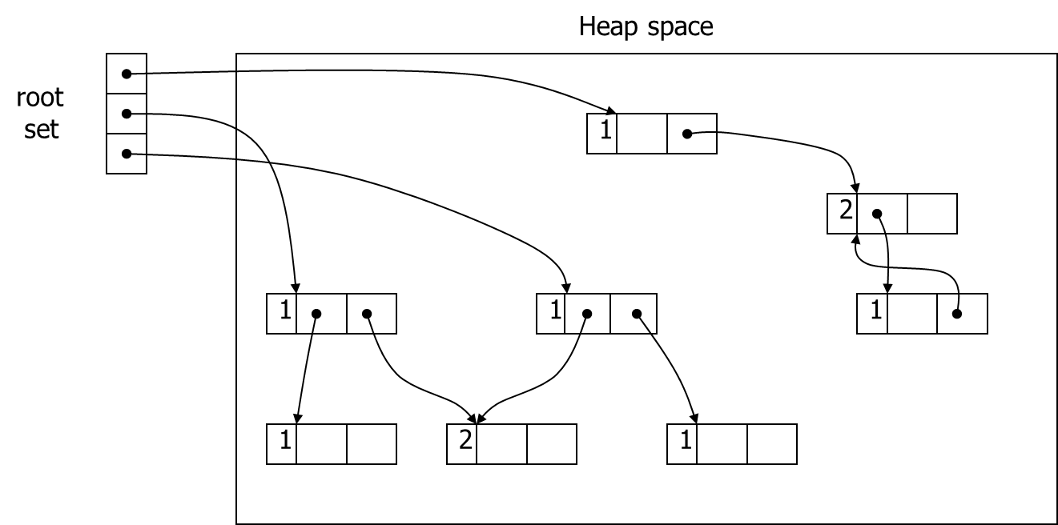
Reference Counting
Idea
Count the number of references to an object.
When count reaches zero, the object memory can be reclaimed.
Overhead
Requires space to store the count for each object.
Time to increment (decrement) each time a reference is added (removed)
Uses
Unix file system uses a reference count for files
C++ “smart pointer” (e.g., auto_ptr) use reference counts

Slide 7
Reference Counting: Example
Heap space
root
set
1
2
1
1
1
0
1
2
0
1
1

Slide 8
Reference Counting: Strengths
Incremental overhead
Cell management interleaved with program execution
Good for interactive or real-time computation
Relatively easy to implement
Can coexist with manual memory management
Spatial locality of reference is good
Access pattern to virtual memory pages no worse than the program, so no excessive paging
Can re-use freed cells immediately
If RC == 0, put back onto the free list

Slide 9
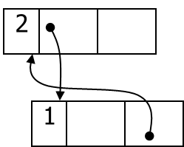
Reference Counting: Weaknesses
Space overhead
1 word for the count, 1 for an indirect pointer
Time overhead
Updating a pointer to point to a new cell requires:
Check to ensure that it is not a self-reference
Decrement the count on the old cell, possibly deleting it
Update the pointer with the address of the new cell
Increment the count on the new cell
One missed increment/decrement results in a dangling pointer / memory leak
Cyclic data structures may cause leaks

Slide 10
Pointers
In Java we have references to refer to dynamically allocated objects; direct access is not possible (like an int, char, float, etc.).
In C/C++ we use pointers: a variable that holds the address of some other variable.
In C++, you can access objects directly!
Benefit: More control than Java.
Drawback: Memory leaks, Memory corruption.
Each pointer takes a static size of 4-bytes in a 32-bit OS, and 8-bytes in a 64-bit OS.
Pointers themselves are saved on the stack, but usually reference heap memory.

Slide 11
Java vs. C++
Java’s References
C++ Pointers
Have access to actual memory locations.
Can point to anything!
The null value in C++ is the number 0 (memory address 0); nullptr in C++.
String s = new String("a string");
The value of the variable 's' is the location of the object on the heap, but we don’t have access to this value!
You cannot have a variable that 'points' to a primitive type
String s = null;
means "I don't have the address of any meaningful data".

Slide 12
Pointer Declarations and Operators
We use the * operator to declare a pointer variable:
<Datatype>* ptrVariable
int* ptr = nullptr;
ptrVariable must contain an address to an item of type Datatype.
Operator Name | Descriptor | Operator | Example(s)
Address Operator | Returns the address of a variable. | & | int value = 10; int* ptrToValue = &value;
Indirection operator | Must be applied to a pointer to return the 'thing' being pointed at. (This is a prefix operator and is not the same as when we declare a pointer.) | * | std::cout << *ptrToValue;
Structure (address) operator | Operator used to reference individual values in a struct, class, or union when the object is a non-pointer. | . | struct Name { std::string first; std::string last; }; struct Name phil; phil.first = "Phil";
Structure pointer operator | Operator used to reference individual values in a struct, class, or union when the object is a pointer. | -> | (&phil)->last = "Samuels";

Slide 13

Visualizing Pointer Operators
ptrToValue
int value = 10;
&
value
int* ptrToValue
=
&value;
10
std::cout << ptrToValue;
std::cout << *ptrToValue;
&phil
&
phil
struct Name phil;
Phil
Samuels
phil.first = "Phil";
struct Name {
std::string first;
std::string last;
};
(&phil)
->last
= "Samuels";
std::cout << phil.first << " " << phil.last;
Exercise 1

Slide 14

Dynamic Allocation with new
With pointer variables we can dynamically allocate space in memory for 'normal' use.
int* score = new int{12}; // Allocate memory and initialize
std::cout << score << " " << *score << std::endl;
std::string* name = new std::string;
*name = "The name goes here.";
std::cout << name << " " << *name << std:: endl;

Slide 15
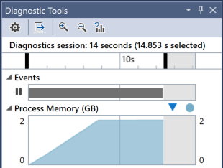
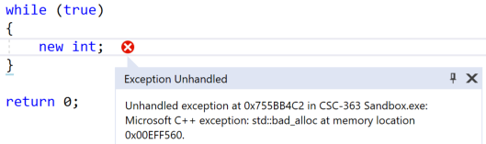
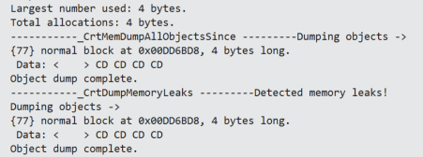
You Must Reclaim Dynamically Allocated Memory
What happens if we continue to allocate memory?
Nothing good…an out of memory exception.
Recall that C/C++ does not use a garbage collector. Therefore, we need to monitor and reclaim any dynamically allocated memory after it is used.
new int;

Slide 16
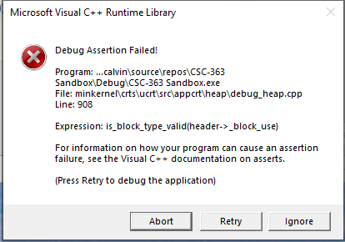
delete
Reclaiming dynamically allocated memory is done through keyword delete (or function free() in C).
int* x = new int;
delete x;
Warning! Do not delete memory on the stack!
int value = 10;
int* ptrToValue = &value;
std::cout << "Address: " << ptrToValue;
delete ptrToValue;
Exercise 2

Slide 17
Deleting Objects: Destructors
Deleting an object is no different than deleting any other pointer.
But what if the object contains dynamically allocated memory? How do we ensure that all nested memory is also freed?
When we create objects, constructors are called. C++ provides corresponding destructor functions for when objects are destroyed.
Destructors:
Are indicated by a ~
Are called implicitly (never explicitly).
When a non-dynamic object is no longer live.
When a pointer to an object is explicitly deleted.
class Rational
// Destructor
virtual ~Rational();
// Constructors
Rational(long numer = 0, long denom = 1);
Rational(const Rational& rhs);
Exercise 3

Slide 18
Rational Class
Consider a Rational class that represents a rational number (integer divided by an integer) as a reduced fraction:
class Rational
{
protected:
long _numer;
long _denom;
inline void reduce();
public:
Rational(long numer = 0, long denom = 1);
Rational(const Rational& rhs);
virtual ~Rational();
// ...
};
Rational::Rational(long numer, long denom) :
_numer(numer), _denom(denom)
{
if (denom == 0)
{
throw "ArithmeticException: divide by 0";
}
reduce();
}
Rational::~Rational()
{
std::cout << "Destructor called on " << this->toString() << std::endl;
}

Slide 19

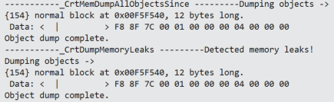
Rational Class
Destructors:
Are indicated by a ~
Are called implicitly (never explicitly).
When a non-dynamic object is no longer live.
When a pointer to an object is explicitly deleted.
void rationals()
{
Rational r1{1, 2};
Rational* r2 = new Rational{ 1, 4 };
std::cout << r1 << std::endl;
std::cout << *r2 << std::endl;
}

Slide 20

Rational Class
Destructors:
Are indicated by a ~
Are called implicitly (never explicitly).
When a non-dynamic object is no longer live.
When a pointer to an object is explicitly deleted.
void rationals()
{
Rational r1{1, 2};
Rational* r2 = new Rational{ 1, 4 };
std::cout << r1 << std::endl;
std::cout << *r2 << std::endl;
delete r2;
}

Slide 21

Dynamic Arrays
We know that int* is the address of an integer somewhere in memory.
Where? Heap or Stack?
Such a variable may point to an integer or (an implied) array of integers.
int* valuePtr = new int{100};
valuePtr
&
10
std::cout << *valuePtr << std::endl;
std::cout << valuePtr[0] << std::endl;
int* arrayPtr = new int[7];
arrayPtr
&
Deletion of arrays requires delete [].
delete [] arrayPtr;

Slide 22

Pointer-Based Array Manipulation
int* arrayPtr = new int[7];
arrayPtr
&
14
12
10
8
6
4
2
Dynamic arrays (as expected) can use bracket-based element access:
for (int i = 0; i < 7; i++)
arrayPtr[i] = 14 - 2 * i;
We can also use pointer arithmetic to access elements:
std::cout << *(arrayPtr + 2) << " " << arrayPtr[2] << std::endl;
std::cout << *(arrayPtr + 4) << " " << arrayPtr[4] << std::endl;
This means we can use pointers to loop through an array.
But there is a problem: how do we know we have reached the end of the array?
Exercise 5

Slide 23
Pointer-Based Array Manipulation (continued)
int i = 0;
for (int* iPtr = arrayPtr; iPtr < arrayPtr + 7; i++, iPtr++)
*iPtr = 14 - 2 * i;
Manipulate
Start
Stop: we need an endpoint.
Advance to next position.
arrayPtr
&
14
12
10
8
6
4
2
iPtr
for (int* iPtr = arrayPtr; iPtr < arrayPtr + 7; iPtr++)
std::cout << *iPtr << " ";

Slide 24
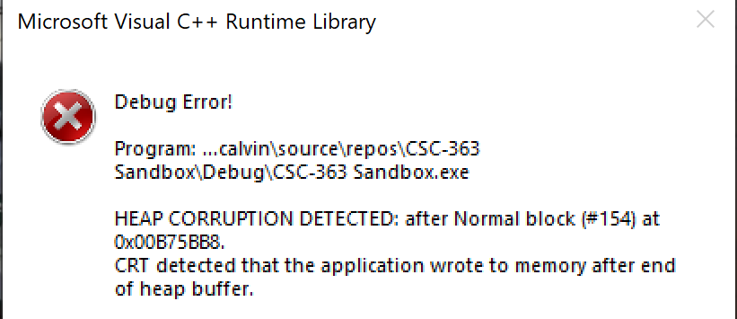
Pointer-Based Array Manipulation (continued)
Can we look before or after or array? Yes, but it is inadvisable.
for (int* iPtr = arrayPtr - 10; iPtr < arrayPtr + 100; iPtr++)
std::cout << *iPtr << " ";
Can we write before or after an array? Possibly. It depends on compiler and system safeguards. It is strongly inadvisable.
Exercise 6

Slide 25
C-Style Strings
We know that a string is a sequence of characters. However, in C, strings are special because of one character:
'\0'
This is known as the terminating character because it is found at the end of the 'legitimate' characters in a string.
char name[11] = "calvin";
c
a
l
v
i
n
\0
0 1 2 3 4 5 6 7 8 9 10
We can use the terminating character as a stopping condition in strings. Therefore, we can write many functions to manipulate C-style strings.
int strlen(char* s)
{
int count = 0;
for ( ; *s != '\0'; count++, s++)
;
return count;
}
std::cout << name << " "
<< strlen(name);

Slide 26
C-Style String Example II
replace takes a C-style string and two characters as input: target and replacement. The function replaces all occurrences of character target by character replacement. As an example, for C-style string str = "abacada", replace(str, 'a', 'A') results in str being "AbAcAdA" with 4 characters being replaced.
int replace(char* s, char toReplace, char replacement)
{
int count = 0;
for ( ; *s != '\0'; s++)
{
if (*s == toReplace)
{
*s = replacement;
count++;
}
}
return count;
}
char s[] = "Check this out!";
int replaced = replace(s, 'h', 'Z');
std::cout << s << "\t(" << replaced << ")" << std::endl;
Exercise 7

Slide 27
Destructors Revisited
Recall that the role of a destructor is to deallocate memory that was dynamically allocated by the class.
class Molecule
{
public:
Molecule();
Molecule(OpenBabel::OBMol* mol, const std::string& theSMI);
~Molecule();
protected:
// The unique identifier for this molecule
unsigned int uniqueIndexID;
// Local atoms and bonds
std::vector<Atom*> atoms;
std::vector<Bond> bonds;
// Used for molecular comparison; the molecule represented
// as a graph
SimpleFragmentGraph* fingerprint;
// An array used to count the number of each specific
// linker / rigid in this molecule
unsigned short int* fragmentCounter;
};
Molecule::~Molecule()
{
for (std::vector<Atom*>::const_iterator a_it = atoms.begin();
a_it != atoms.end(); a_it++)
{
delete (*a_it);
}
atoms.clear();
bonds.clear();
if (fragmentCounter)
delete[] fragmentCounter;
fragmentCounter = 0;
}

Slide 28
Structures (structs) in C
C provides one way to aggregate variables into a more cohesive representation: struct.
We might aggregate the contents of a flight message.
We might construct a linked list implementation of an <integer, integer> map using a Node struct.
struct Message
{
int time;
int latitude;
int longitude;
int speed;
bool isOn;
};
struct Node
{
int data;
int key;
struct Node *next;
};
struct Node lNode;
lNode.data = 100;
lNode.key = 1;
struct Node rNode;
rNode.data = 74;
rNode.key = 12;
lNode.next = &rNode;
printf("%d, %d\n", lNode.next->key,
lNode.next->data);
struct Message msg;
msg.time = 0;
msg.latitude = 4;
msg.longitude = 10;
msg.speed = 1000;
msg.isOn = true;
printf("%d, %d, %d, %d, %d\n",
msg.time, msg.latitude,
msg.longitude, msg.speed, msg.isOn);
Interview Question: What is the difference between a struct and a class in C++?

Slide 29
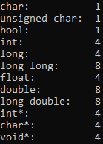
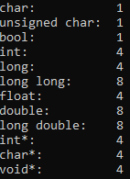
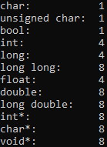
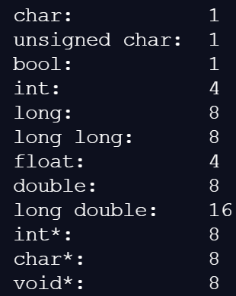
Byte Size of Datatypes
The number of bytes associated with each primitive datatype is system dependent.
std::cout << "char:\t\t" << sizeof(char) << std::endl;
std::cout << "unsigned char:\t" << sizeof(unsigned char) << std::endl;
std::cout << "bool:\t\t" << sizeof(bool) << std::endl;
std::cout << "int:\t\t" << sizeof(int) << std::endl;
std::cout << "long:\t\t" << sizeof(long) << std::endl;
std::cout << "long long:\t" << sizeof(long long) << std::endl;
std::cout << "float:\t\t" << sizeof(float) << std::endl;
std::cout << "double:\t\t" << sizeof(double) << std::endl;
std::cout << "long double:\t" << sizeof(long double) << std::endl;
std::cout << "int*:\t\t" << sizeof(int*) << std::endl;
std::cout << "char*:\t\t" << sizeof(char*) << std::endl;
std::cout << "void*:\t\t" << sizeof(void*) << std::endl;
64-bit Laptop
x86 Mode
64-bit Desktop
x86
x64
repl.it server

Slide 30
Bit-Based Representation
It is often the case that we create variables with datatypes that are too large for what we require.
How many bits does a Boolean variable require?
Ideally, 1 although 8 bits is common (see previous slide).
Although data compaction is not as important as it once was, C/C++ allows us to specify the number of bits.
struct Message
{
int time : 12;
int latitude : 20;
int longitude : 20;
int speed : 11;
bool isOn : 1;
};
struct Message msg;
msg.time = 0;
msg.latitude = 4;
msg.longitude = 10;
msg.speed = 1000;
msg.isOn = true;
printf("%d, %d, %d, %d, %d\n",
msg.time, msg.latitude,
msg.longitude, msg.speed, msg.isOn);

Slide 31



sizeof Structs and Buffering
The size of a structure is dependent on how bit-fields are specified and is compiler/system-dependent.
struct Message
{
int time : 12;
int latitude : 20;
int longitude : 20;
int speed : 11;
bool isOn : 1;
};
struct Message
{
int time : 8;
int latitude : 24;
int longitude : 20;
int speed : 11;
int isOn : 1;
};
std::cout << sizeof(struct Message);
std::cout << sizeof(struct Message);
struct SmallMessage
{
int a : 1;
int b : 2;
int c : 3;
int d : 4;
int e : 6;
int buffer : 16;
};
struct SmallMessage
{
int a : 1;
int b : 2;
int c : 3;
int : 2;
int d : 4;
int e : 6;
int : 14;
};
struct SmallMessage
{
int a : 1;
int : 2;
int b : 2;
int c : 3;
int : 14;
int d : 4;
int e : 6;
};
Unnamed bit-fields

Slide 32
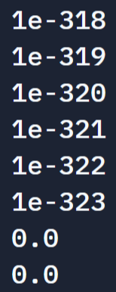
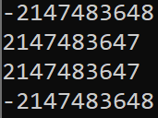

Boundedness of Primitive Values in C/C++
Python uses arbitrary-length integers.
def factorial(n):
result = 1
for i in range(1, n):
result *= i
return result
But, not arbitrary-precision floating-point numbers.
def divide():
n = 1
for i in range(1,380):
print(n)
n /= 10
If data is represented using a fixed number of bits, that means only a finite number of values can be represented.
std::cout << INT_MIN << std::endl;
std::cout << INT_MIN - 1 << std::endl;
std::cout << INT_MAX << std::endl;
std::cout << INT_MAX + 1<< std::endl;
std::cout << 0x7FFFFFFF << std::endl; // INT_MAX
std::cout << 0x7FFFFFFF + 1 << std::endl; // INT_MIN

Slide 33
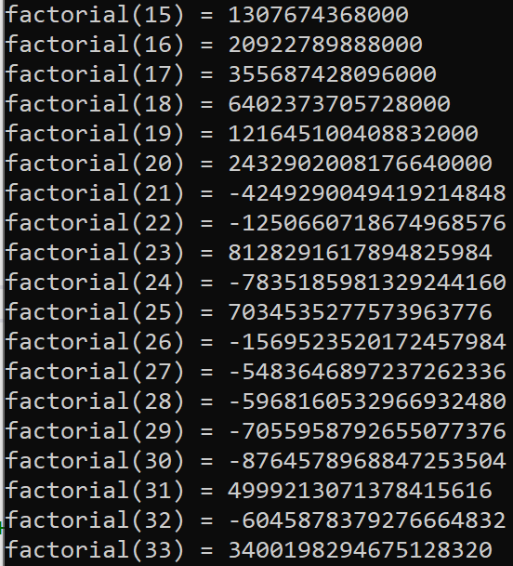
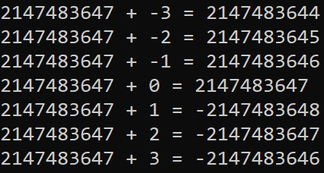
Arithmetic Overflow
Arithmetic Overflow:
When the result of an operation exceeds the maximum (or minimum value) for a particular datatype.
int n = INT_MAX;
for (int i = -3; i < 4; i++)
{
std::cout << n << " + " << I
<< " = " << n + I
<< std::endl;
}
long long int factorial(int n)
{
long long int result = 1;
for (int i = 1; i <= n; i++)
{
result *= i;
}
return result;
}

Slide 34
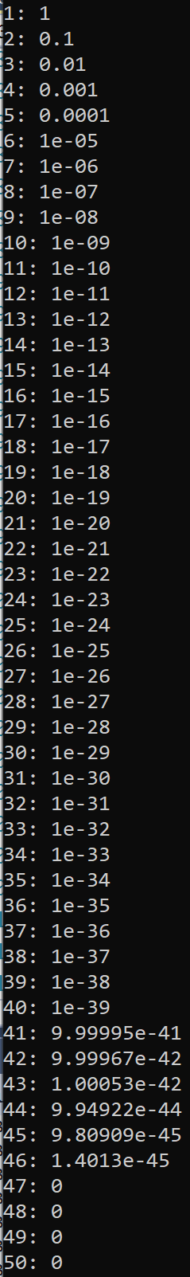
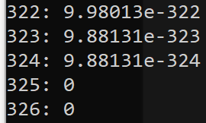
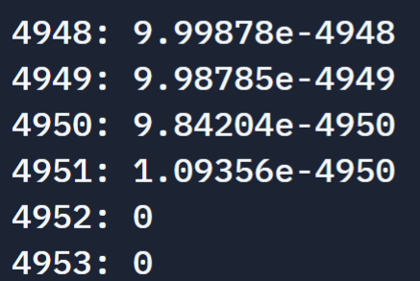
Arithmetic Underflow
Arithmetic Underflow:
When the result of an operation is more precise than can be stored in memory (a register).
float n = 1.0;
for (int i = 1; i < 100; i++)
{
std::cout << i << ": " << n << std::endl;
n /= 10;
}
8-byte double
16-byte long double (repl.it)

Slide 35
Bounds of Bit-Based Representation
Specifying the allocated number of bits for a datatype shrinks the allowable range of values.
struct Message
{
int time : 8;
int latitude : 24;
int longitude : 20;
int speed : 11;
int isOn : 1;
};
struct Message msg;
msg.time = 0xFF;
msg.latitude = 0xFFFFFF;
msg.longitude = 0xFFFFF;
msg.speed = 0x7FF;
msg.isOn = 0x1;
printf("%d, %d, %d, %d, %d\n",
msg.time, msg.latitude,
msg.longitude, msg.speed, msg.isOn);
msg.time = 0x7F;
msg.latitude = 0x7FFFFF;
msg.longitude = 0x7FFFF;
msg.speed = 0x3FF;
msg.isOn = 0x1;
For variables of unsigned type, the minimum is 0 and the maximum is given by -1 == 0xFFFFFFFF.
struct Message
{
unsigned int time : 8;
unsigned int latitude : 24;
unsigned int longitude : 20;
unsigned int speed : 11;
unsigned int isOn : 1;
};
msg.time = -1;
msg.latitude = -1;
msg.longitude = -1;
msg.speed = -1;
msg.isOn = -1;

Slide 36
Bitwise Operators
Our goal is to manipulate data at the bit-level. C / C++ has many bitwise operators to facilitate these manipulations.
Operator | Name | Operator Type | Description | Example
| | OR | Binary | Copies a bit if it exists in either operand. | 0x55 | 0xAA → 0xFF
& | AND | Binary | Copies a bit to the result if it exists in both operands. | 0x55 & 0xAA → 0x00
^ | XOR | Binary | Copies the bit if it is set in one operand but not both. | 0xFF ^ 0xAA → 0x55
~ | One's Complement | Unary | Has the effect of 'flipping' bits. | ~0xAA → 0xFFFFFF55
<< | Left Shift | Binary | The left operands value is moved left by the number of bits specified by the right operand. | 0x55 << 1 → 0xAA
>> | Right Shift | Binary | The left operands value is moved right by the number of bits specified by the right operand. | 0xAA >> 1 → 0x55
Exercise 8
Exercise 9-15

Slide 37
Bit-Masking
How do we extract bits from a block of memory? Or, in particular, how can we extract a single bit or a block of bits from another variable?
A mask defines which bits you want to keep, and which bits you want to clear.
Masking is the act of applying a mask to a value.

Slide 38

Bit-Masking
 | 1 1 1 0 1 1 0 1 | input
& | 0 0 1 1 1 1 0 0 | mask
 | 0 0 1 0 1 1 0 0 | result
 | 1 1 1 0 1 1 0 1 | input
| | 0 0 1 1 1 1 0 0 | mask
 | 1 1 1 1 1 1 0 1 | result
 | 1 1 1 0 1 1 0 1 | input
^ | 0 0 1 1 1 1 0 0 | mask
 | 1 1 0 1 0 0 0 1 | result
'Extracts' a subset of the bits in a value.
'Sets' a subset of the bits from a value.
'Toggle' a subset of the bits in a value.
In general, bit-level manipulation presumes unsigned data (i.e., we view our data as a stream of bits / bytes that we are manipulating).
Write an expression will extract 'first' byte of an unsigned 32-bit value.
Exercise 16
uint8_t firstByte(uint32_t value) { return value & 0xFF; }
std::cout << std::hex << (0xDEADBEEF & 0xFF) << std::endl;

